Slide 1
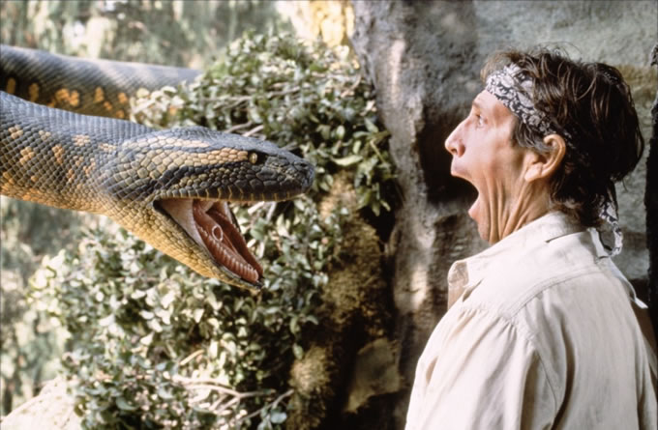

ANACONDA Training session
Guillaume Stanguennec
October 2016

Slide 2
Agenda
A little bit of context
Overview of the capabilities through one example
Hands on exercise on the basics
Real life exercise, let’s help chimes
What else can we do with this tool?
Questions, suggestions

Slide 3
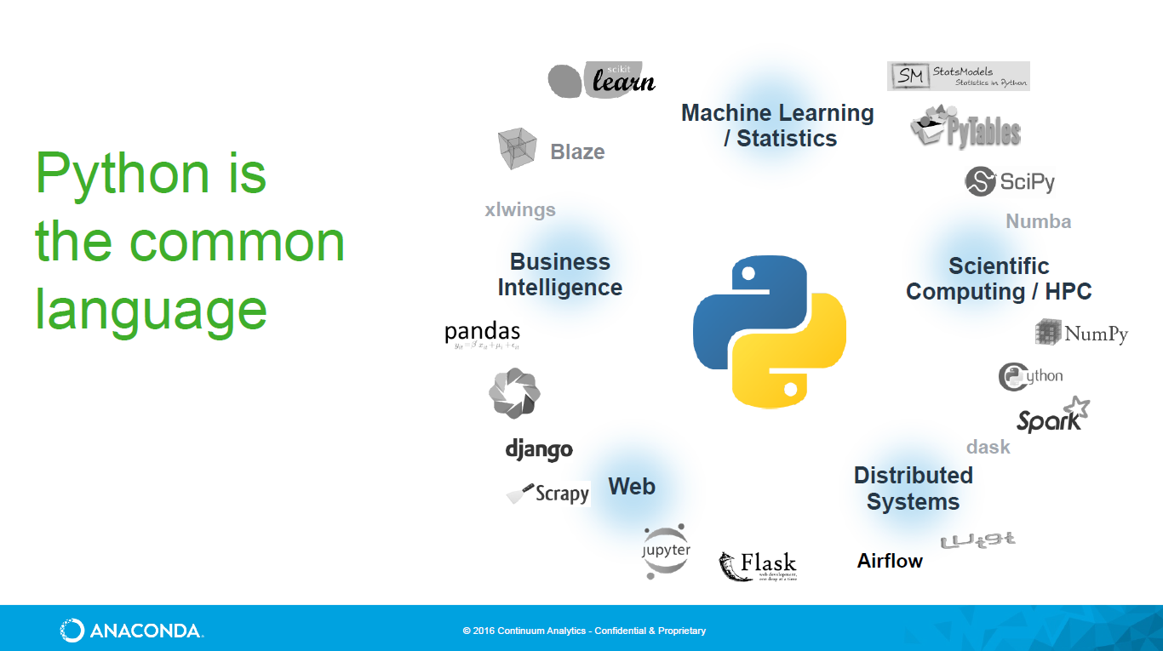
1. A little bit of context
A. Python eco-system

Slide 4
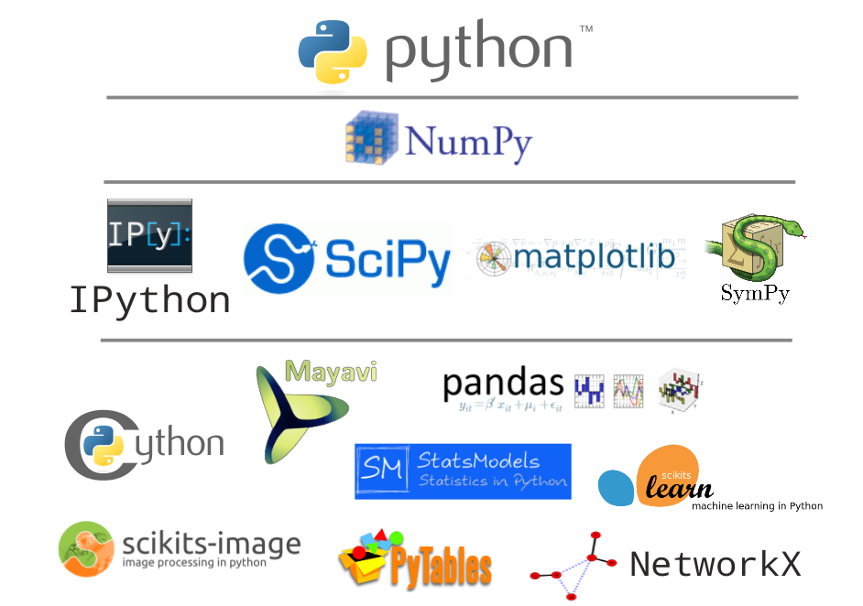
1. A little bit of context
B. Python scientific ecosystem
Ground floor
1st floor
Structure data in matrices
2nd floor
Interactive console
Scientific library
Plotting library
3rd floor

Slide 5
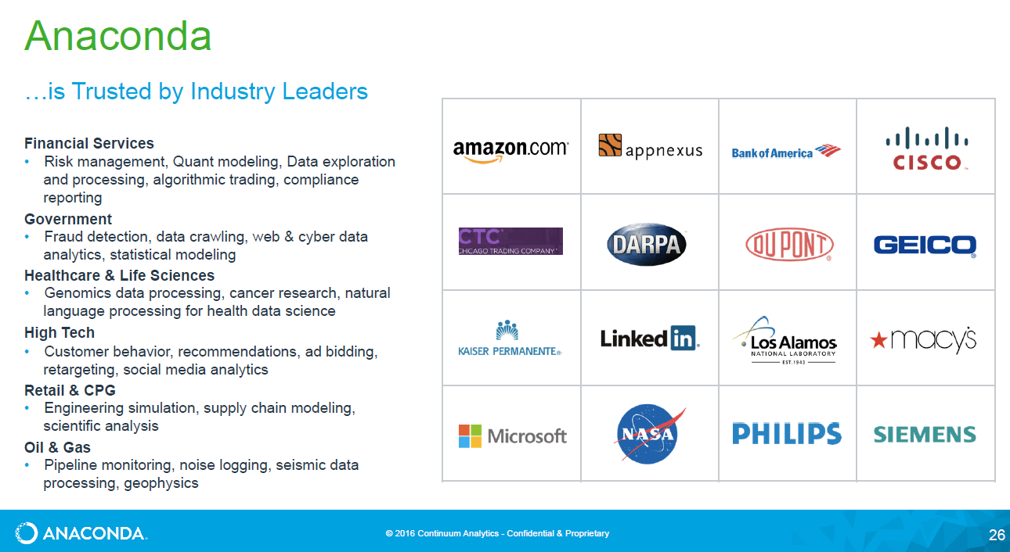
1. A little bit of context
C. Anaconda leadership

Slide 6
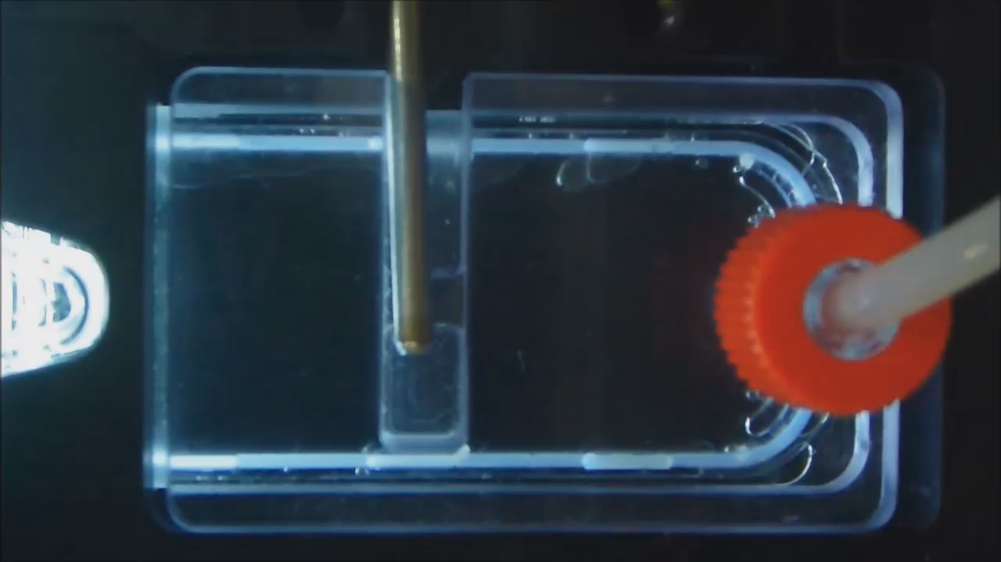
2. Overview of the capabilities through one example
Micro-scavenge is used to get rid of bubbles within the incubation chamber
It lasts 40ms, close to 25ms valve response time
How do you characterize it ?
How reliable is it?

Slide 7
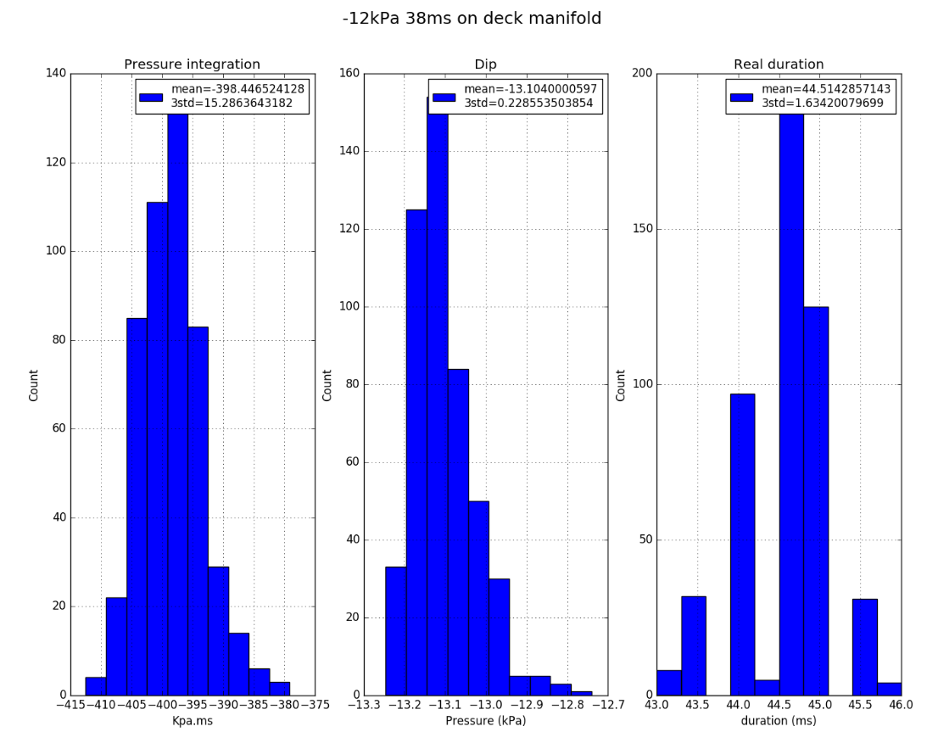
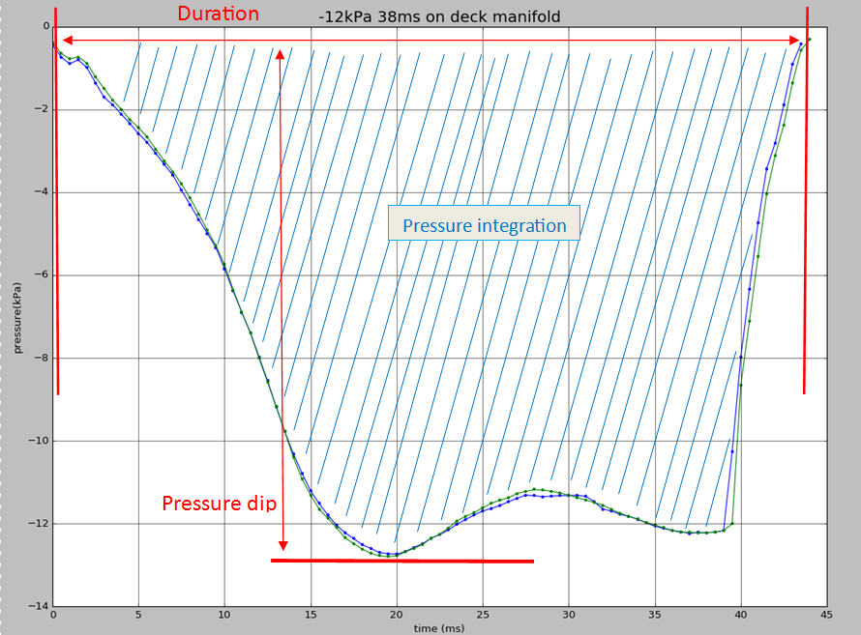
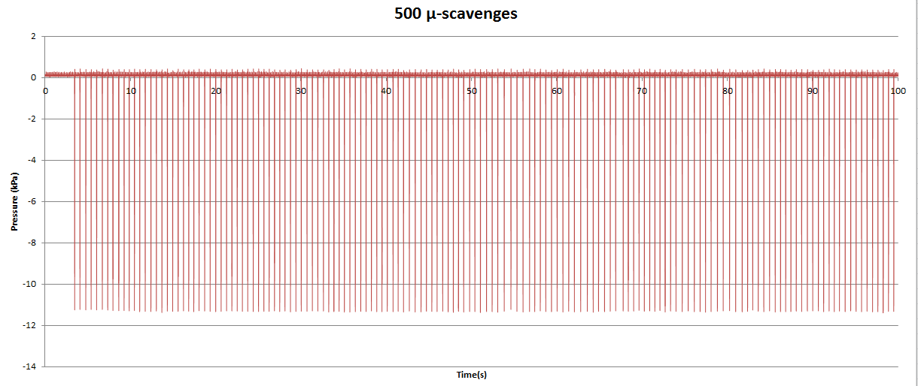
2. Overview of the capabilities through one example

Slide 8
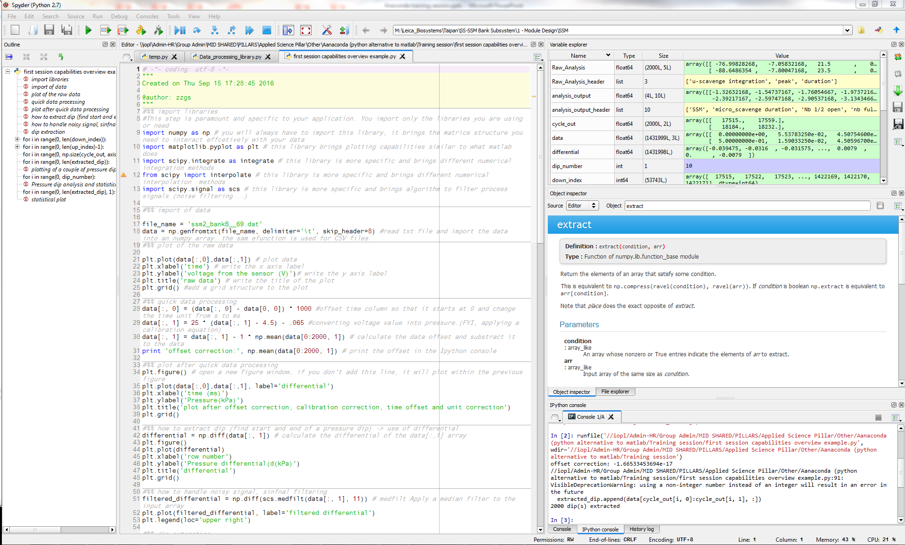
2. Overview of the capabilities through one example
Variable in memory
-> quick data visualisation
Code outline
structure
Code editor
Function documentation
Interactive Console

Slide 9
3. Hands on exercise on the basics
Hands on Example on SPYDER

Slide 10
4. Real life exercise, let’s help chimes
Hands on Example on SPYDER

Slide 11
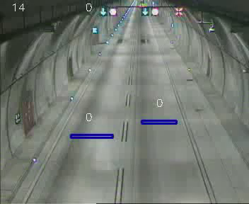
5. What else can we do with this tool?
a. Computer vision (open CV)

Slide 12
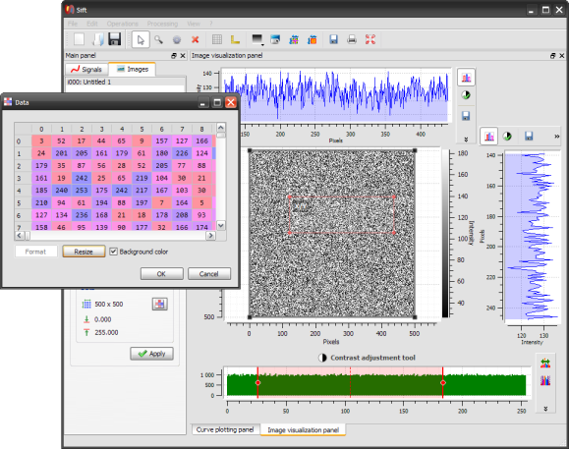
5. What else can we do with this tool?
b. Make GUI

Slide 13
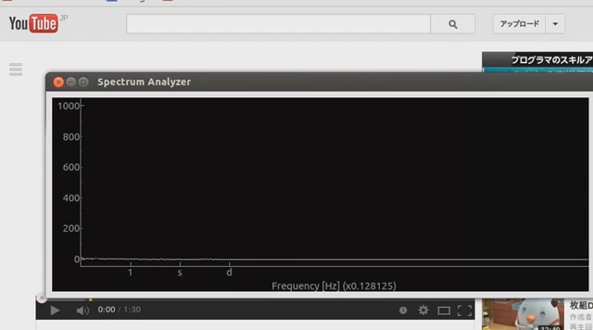
5. What else can we do with this tool?
c. Interaction with hardware, networks , real time etc.

Slide 14
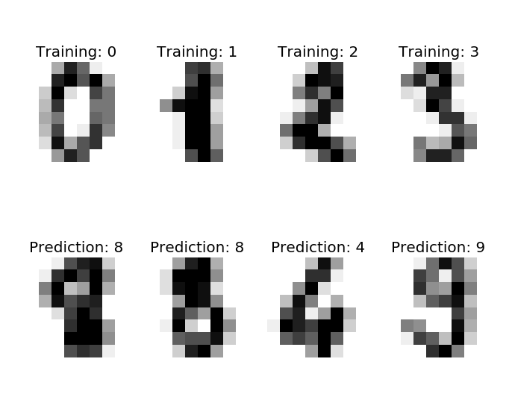
5. What else can we do with this tool?
d. Machine learning -> scikit - learn

Slide 15
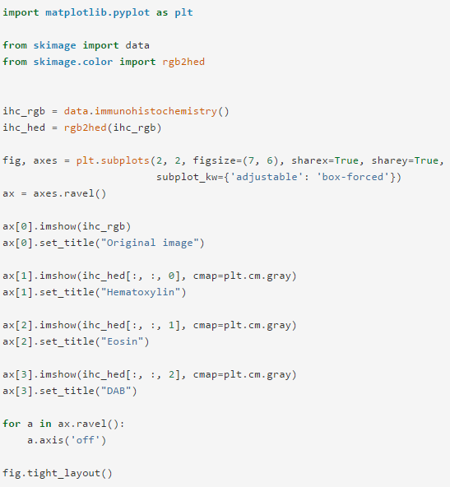
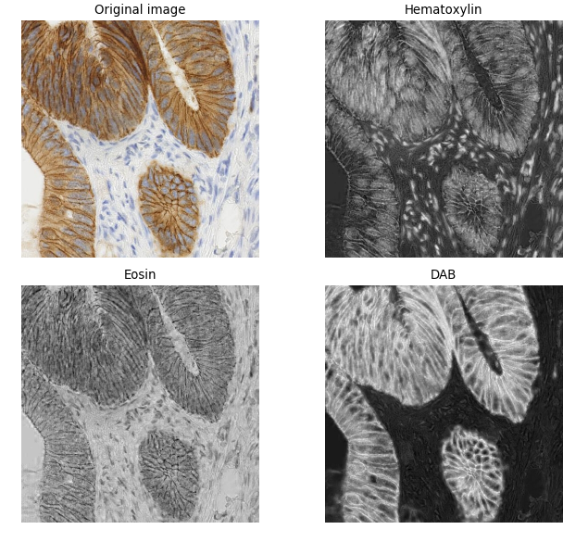
5. What else can we do with this tool?
e. Image processing

Slide 16
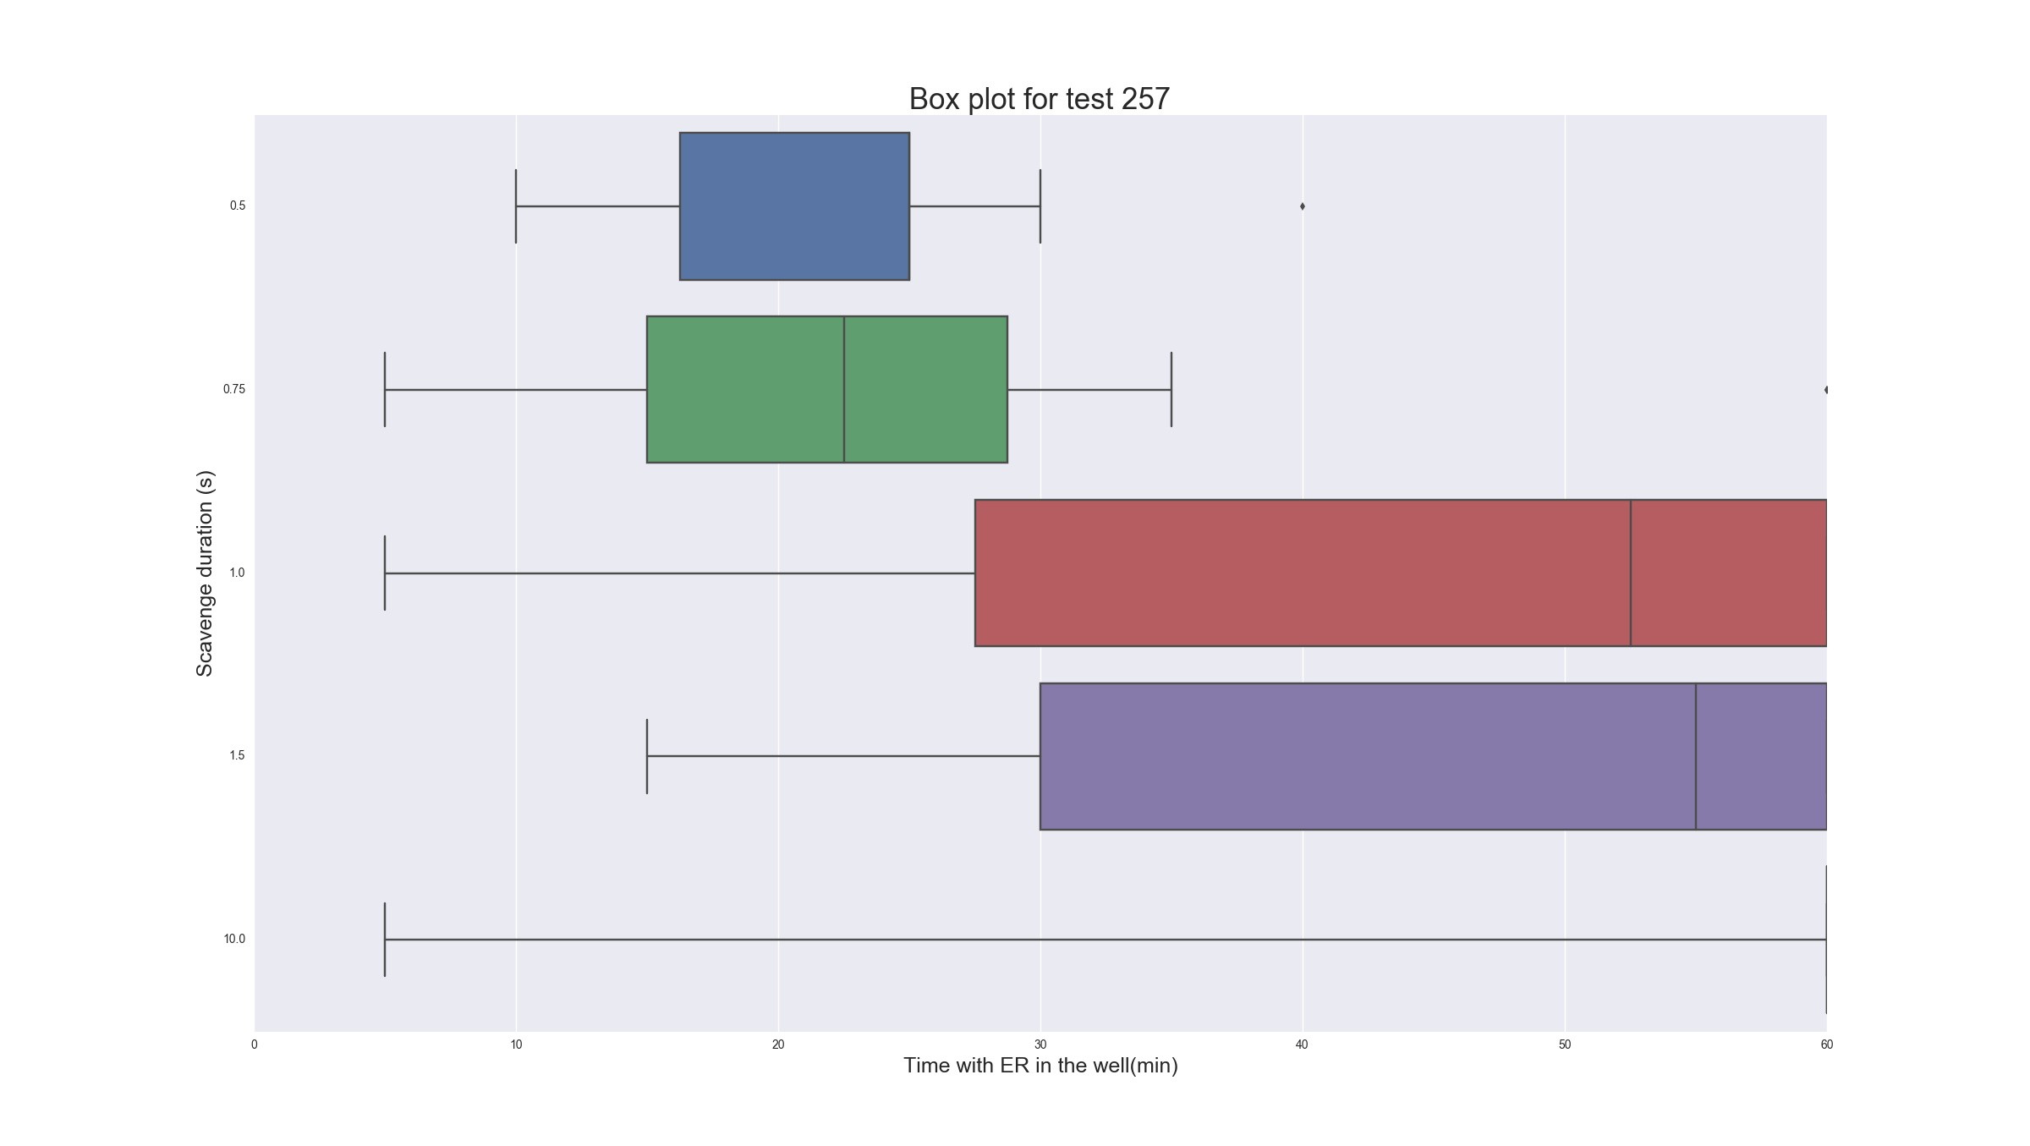
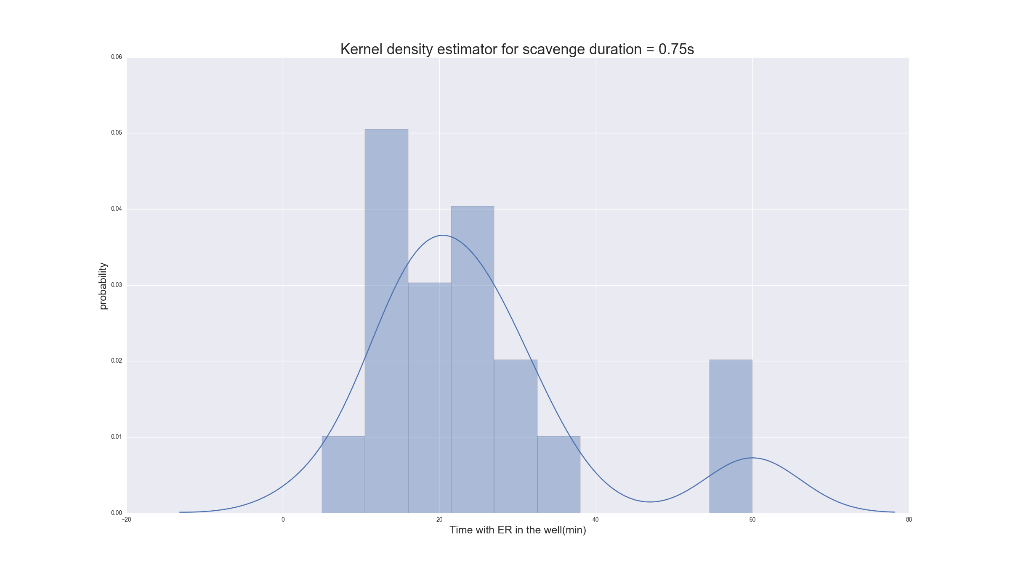
5. What else can we do with this tool?
f. Statistical plots

Slide 17

2. Questions, suggestions ??

